Slide 1

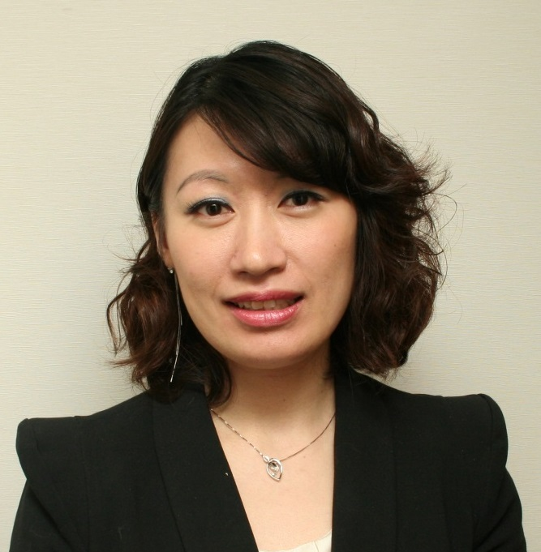

TLS健康生活纖營計劃
TLS Weight Loss Solution
Emmy Yeung
產品拓展經理
Product Manager
本簡報中提到的收入等級純屬舉例說明，無意代表美安香港超連鎖™店主的一般收入，也無意表示任何超連鎖™店主皆可賺取同等收入。美安香港超連鎖™店主的成功與否，取決於其在發展事業時的努力、才能與投入程度。The income levels mentioned in the following presentation are for illustration purposes only. They are not intended to represent the income of a typical Market Hong Kong UnFranchise ™Owner, nor are they intended to represent that any given Independent UnFranchise ™ Owner will earn income in that amount. The success of any Market Hong Kong Independent UnFranchise ™ Owner will depend upon the amount of hard work, talent, and dedication which he or she devotes to building his or her Market Hong Kong Business.

Slide 2



The Most Customizable Weight Loss Solution On The Planet
TLS® Weight Loss Solution

Slide 3

4
Science-based Components
Low-glycemic Impact Eating
Body Composition: Fat, Muscle & Metabolism
Supplements
Education
START LIVING WITH TLS® TODAY
#FINDYOURFIT
#TLSWEIGHTLOSS

Slide 4



Program Selections from TLS®
12 weeks program
21-day challenge
7-day detox
Fat Shredder
Rapid Results
Sure & Steady
Continued Commitment
START LIVING WITH TLS® TODAY
#FINDYOURFIT
#TLSWEIGHTLOSS

Slide 5
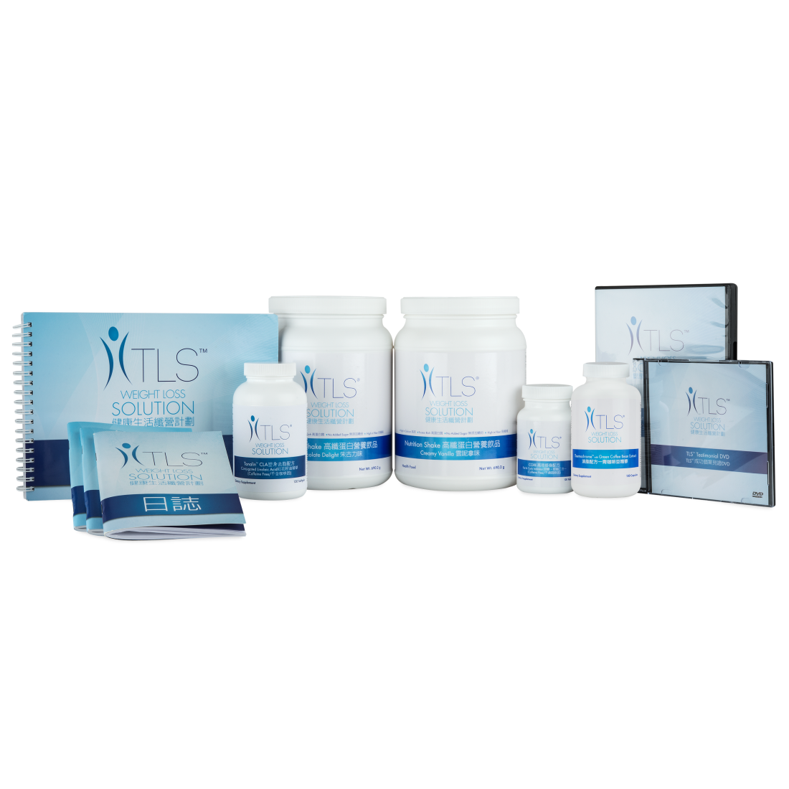
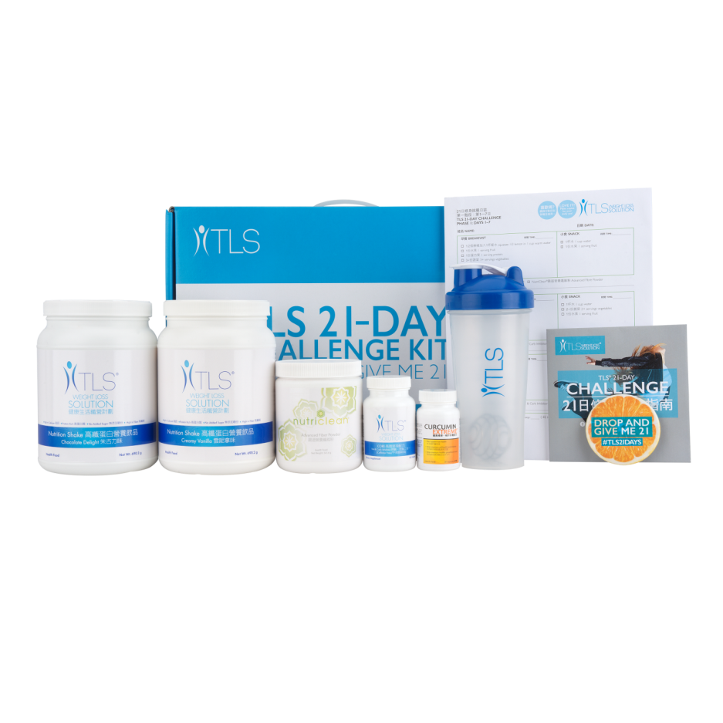
Product Selections from TLS
TLS ® 21-DAY
CHALLENGE KIT
TLS ® WEIGHT LOSS SOLUTION KIT
Code: HK21DAY
UC $1,038.00 | SR $1,452.00 | BV 25.0
Code: varies
UC $1,330.00 | SR $1,859.00 | BV 80.0
START LIVING WITH TLS TODAY
#FINDYOURFIT
#TLSWEIGHTLOSS

Slide 6
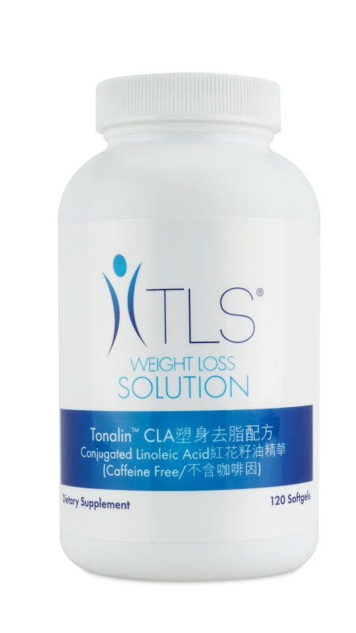
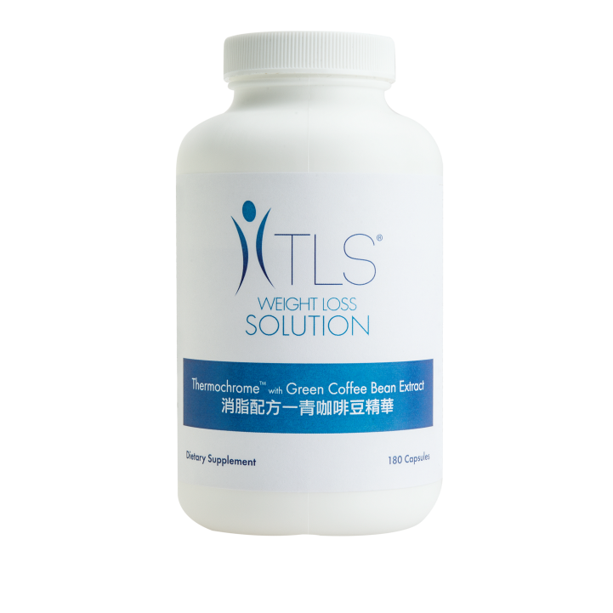
Product Selections from TLS
TLS® Thermochrome with Green Coffee Bean Extract
TLS® Tonalin CLA
Code: HK6406
UC $313.00 | SR $438.00 | BV 25.0
Code: HK6428
UC $293.00 | SR $410.00 | BV 22.0

Slide 7
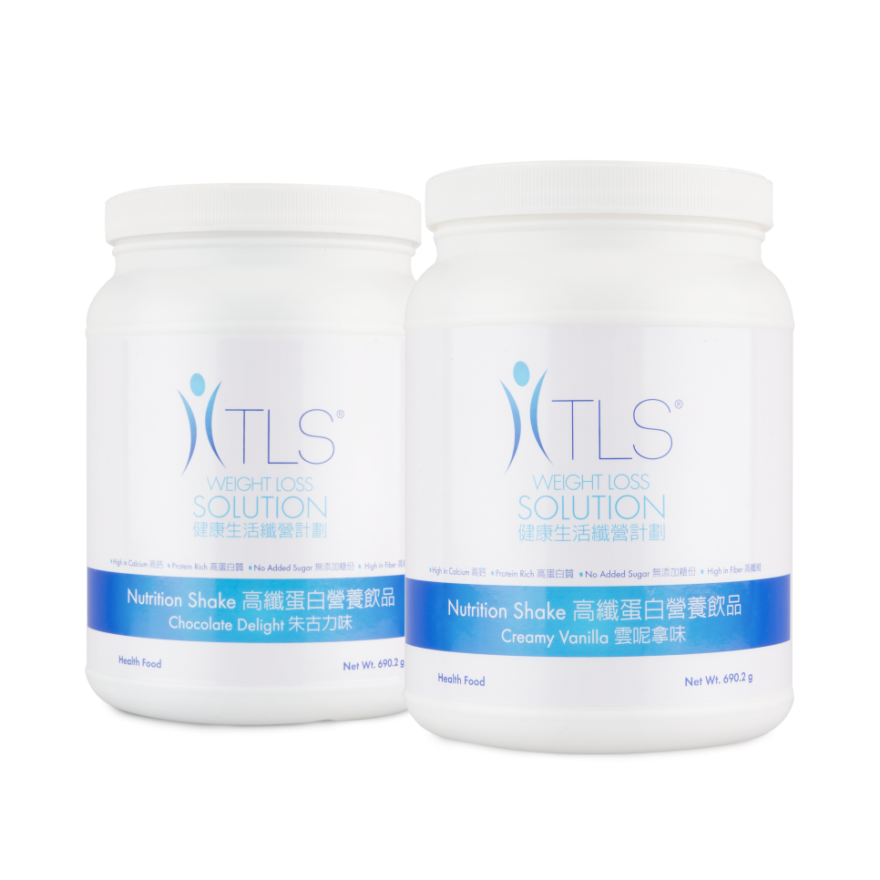
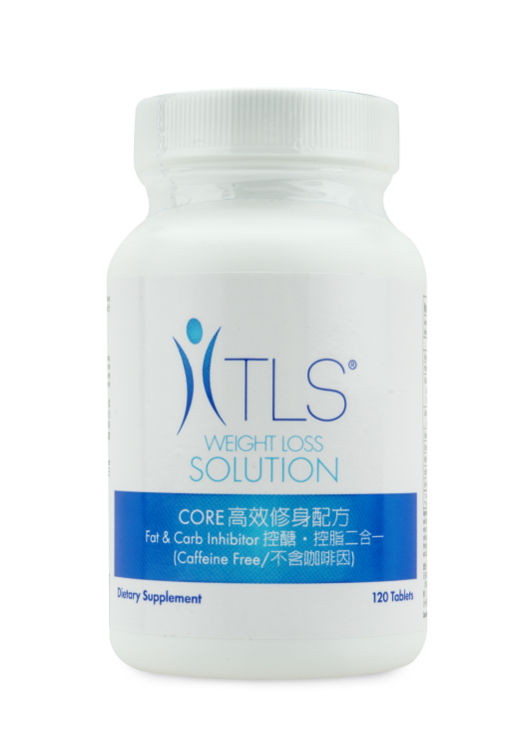
Product Selections from TLS
TLS ® CORE
TLS® Nutrition Shakes
Code: HK6462
UC $360.00 | SR $503.00 | BV 32.0
Code: varies
UC $208.00 | SR $291.00 | BV 8.0

Slide 8
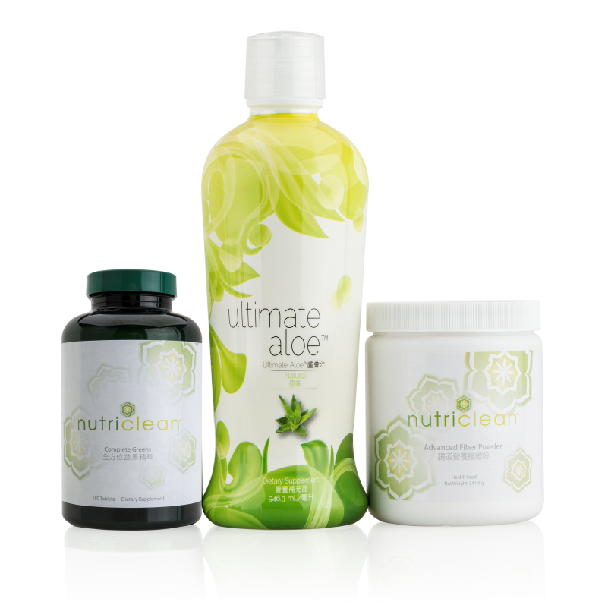
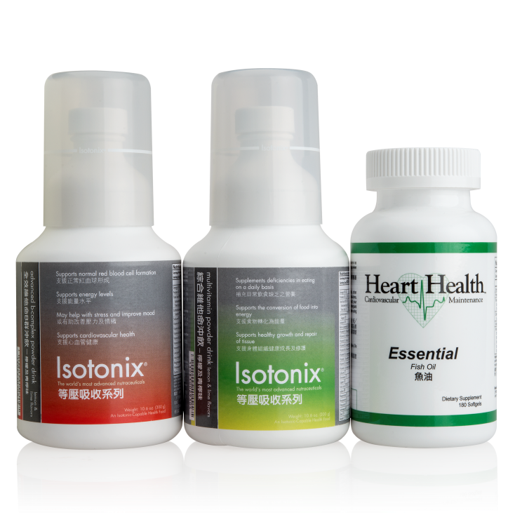
Product Selections from TLS
Detox Kit
Optimal Wellness Kit
Code: varies
UC $593.00 | SR $830.00 | BV 49.0
Code: HK6475
UC $702.00 | SR $983.00 | BV 50.0

Slide 9




WEIGHT LOSS ISN’T MAGIC, IT’S SCIENCE.
Short-Term Results
Long-Term Solution

Slide 10

HK.TLSSLIM.COM is now available!

Slide 11
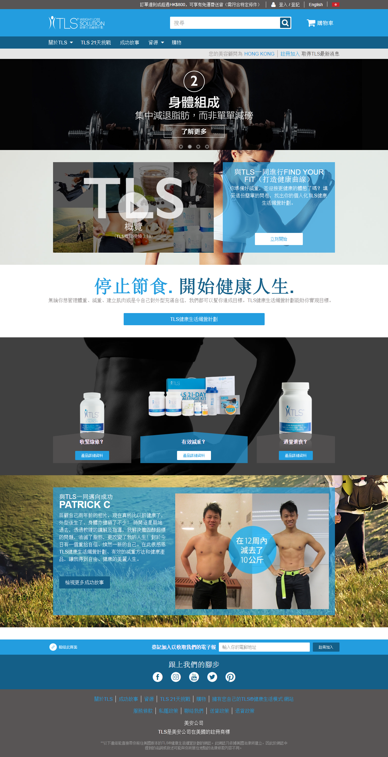

Slide 12
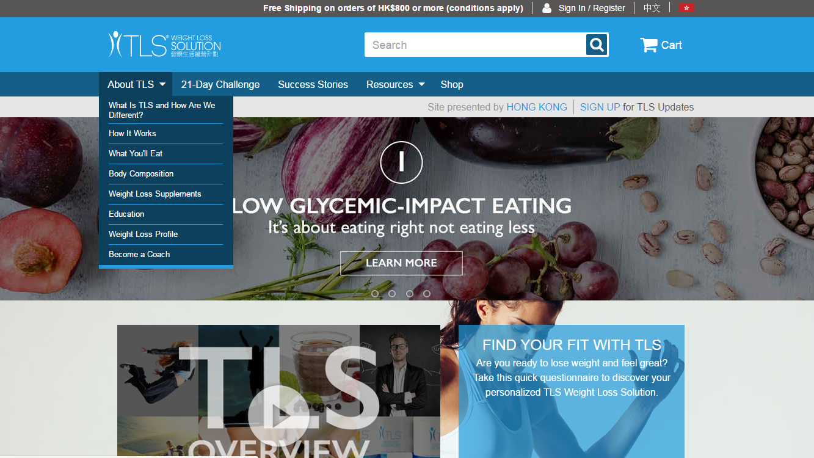
About TLS

Slide 13
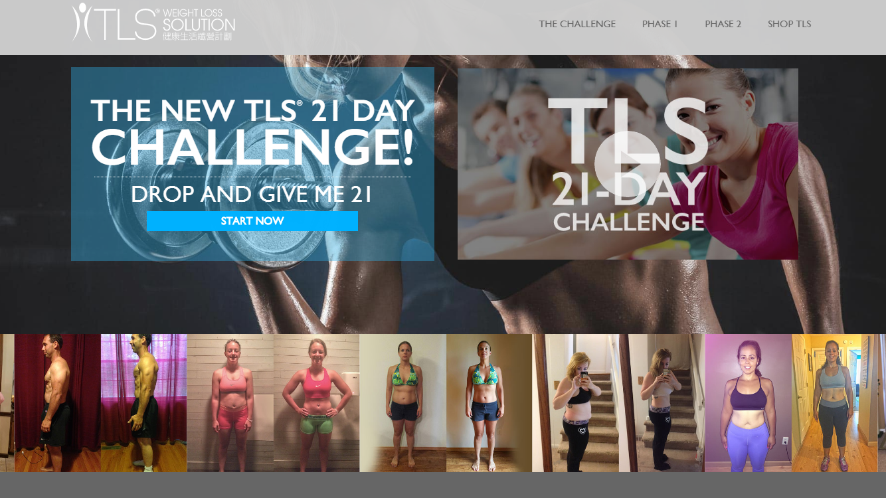
TLS
21 Day Challenge

Slide 14
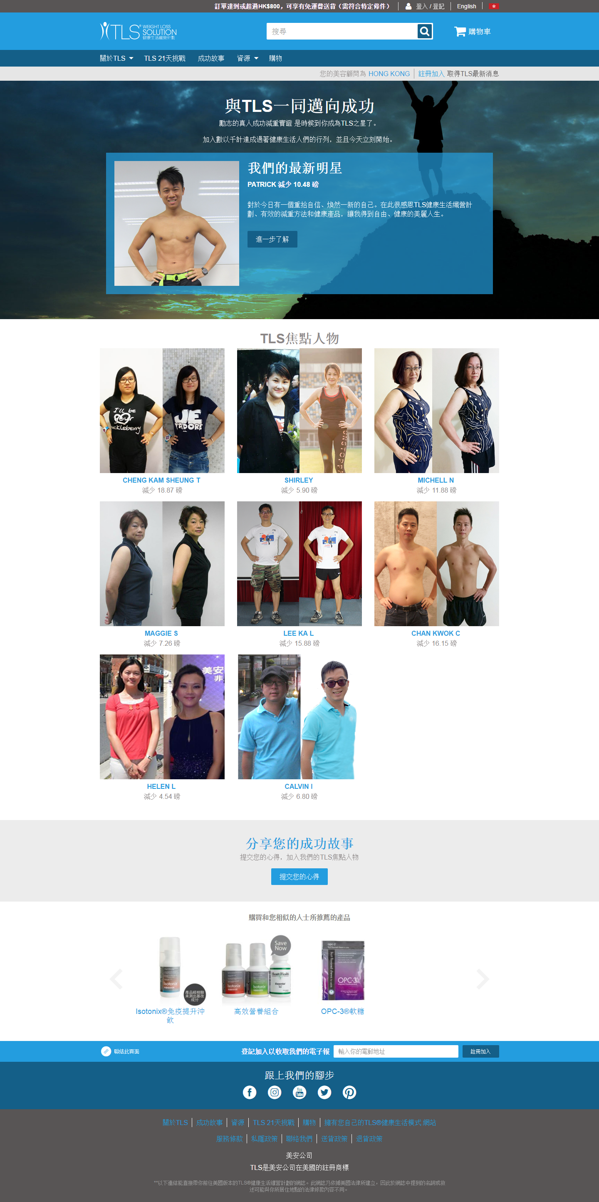
Success Stories

Slide 15
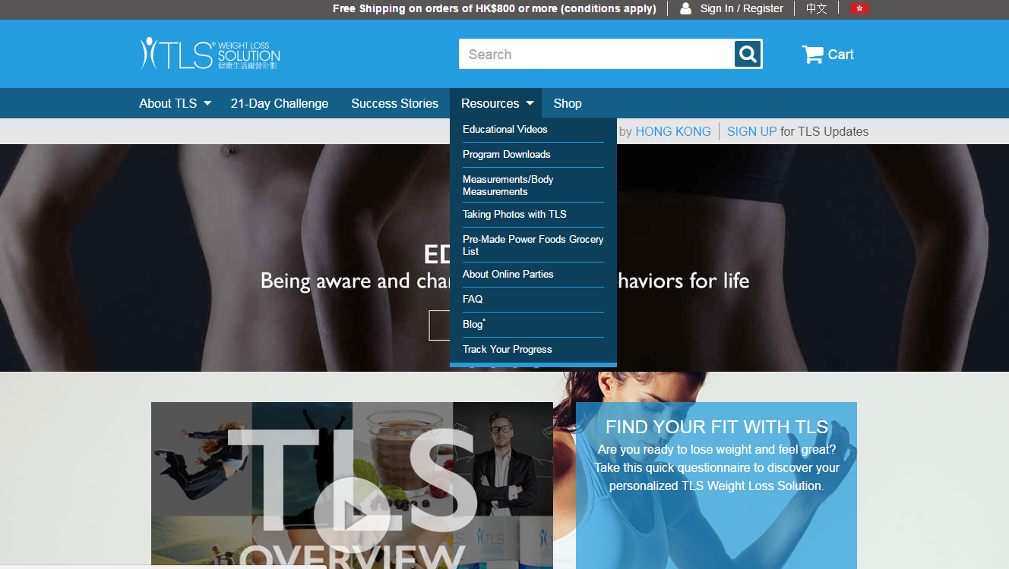
Resources

Slide 16
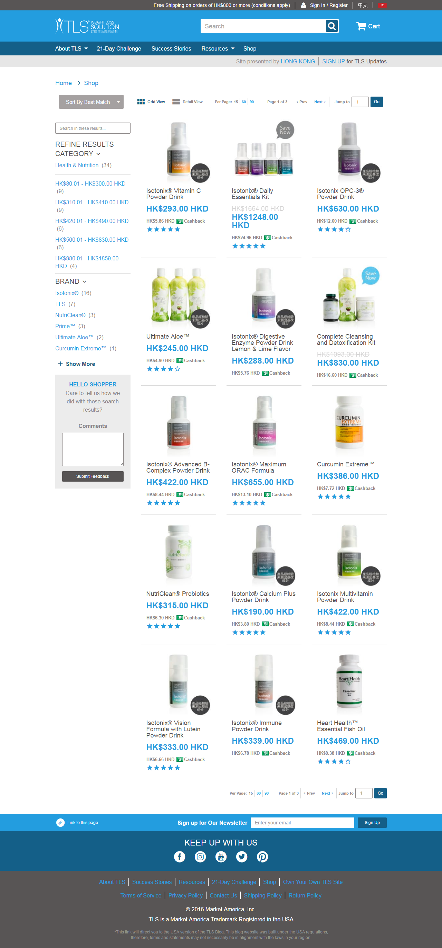
Shop

Slide 17
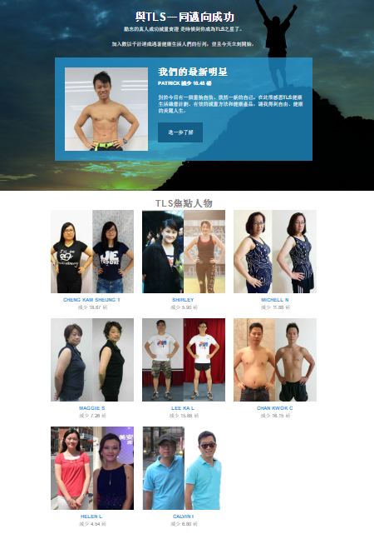
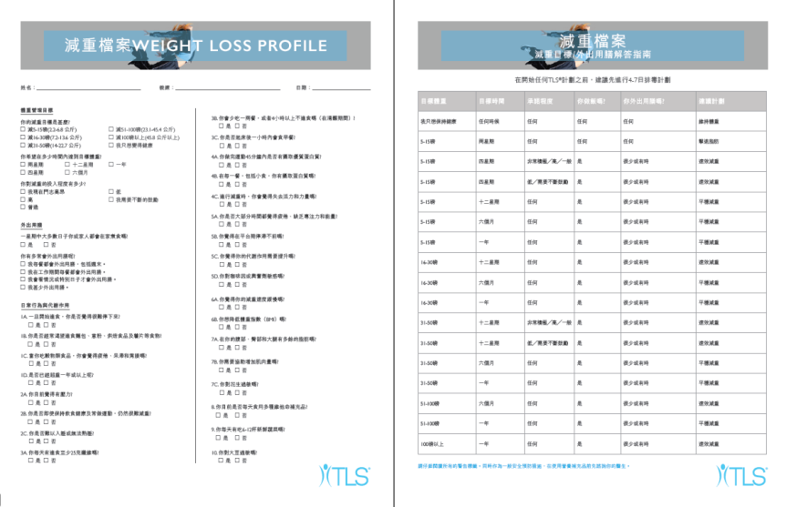

Find what you need to succeed at HK.TLSSLIM.COM
FREE personalized weight loss plans
Educational videos
BMI calculator
Body fat calculator
Health & Wellness blog
Success stories
Online Parties
Pintable Grocery Lists

Slide 18

Coming soon…
Health Guide &
Journal

Slide 19
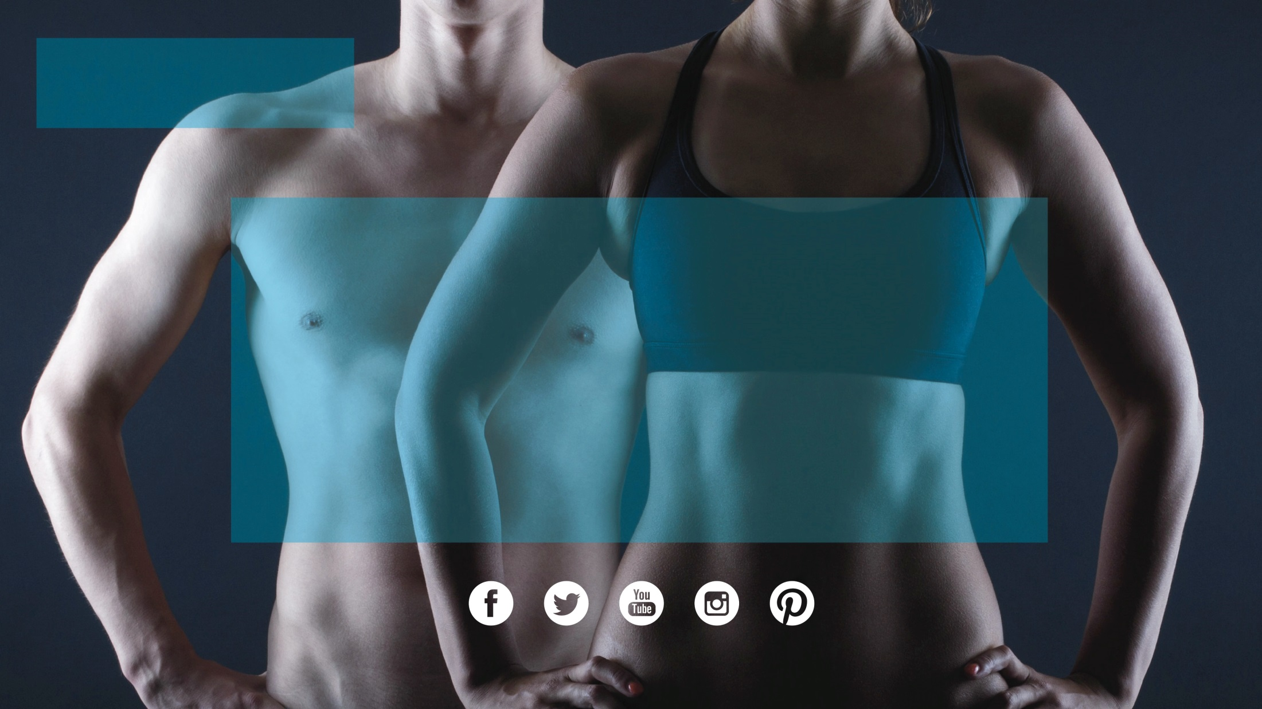

®
There are good reasons
to make TLS® your major!

Slide 20
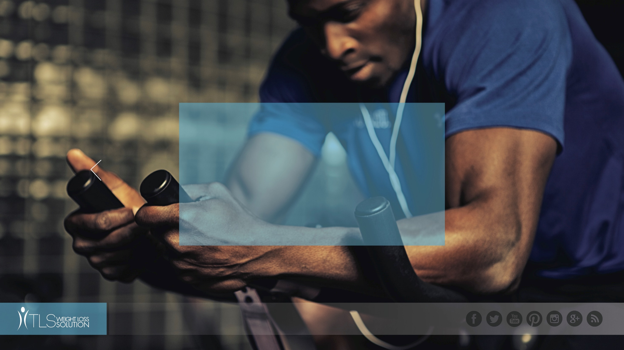
TLS® 21-Day
Challenge

Slide 21
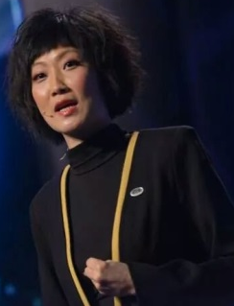
TLS健康生活纖營計劃
TLS Weight Loss Solution
Frances Siu
專業經理級
Professional Coordinators
四個佣金週期共賺取HK$34,500
HK$34,500 in 4 Commission weeks
本簡報中提到的收入等級純屬舉例說明，無意代表美安香港超連鎖™店主的一般收入，也無意表示任何超連鎖™店主皆可賺取同等收入。美安香港超連鎖™店主的成功與否，取決於其在發展事業時的努力、才能與投入程度。The income levels mentioned in the following presentation are for illustration purposes only. They are not intended to represent the income of a typical Market Hong Kong UnFranchise ™Owner, nor are they intended to represent that any given Independent UnFranchise ™ Owner will earn income in that amount. The success of any Market Hong Kong Independent UnFranchise ™ Owner will depend upon the amount of hard work, talent, and dedication which he or she devotes to building his or her Market Hong Kong Business.

Slide 22
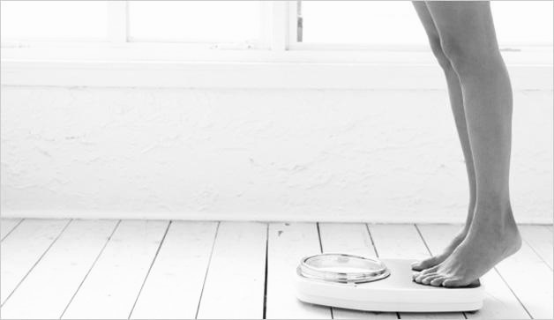
Is there a market?
Are you concerned about a family history of weight related health challenges?
Are you concerned about sleep quality or energy?
Are you concerned about rapid aging?
Are you concerned about sexual desire?
Are you concerned about joint discomfort?
Are you interested in looking and feeling better?

Slide 23
Why take the 21-Day Challenge?
Always feel tired
Want to be prettier and fitter
Gain muscle mass, tone up
Lose 5-20 lbs. of body fat
Jumpstart a long term weight loss journey
… should join the challenge
START LIVING WITH TLS® TODAY
#FINDYOURFIT
#TLSWEIGHTLOSS

Slide 24
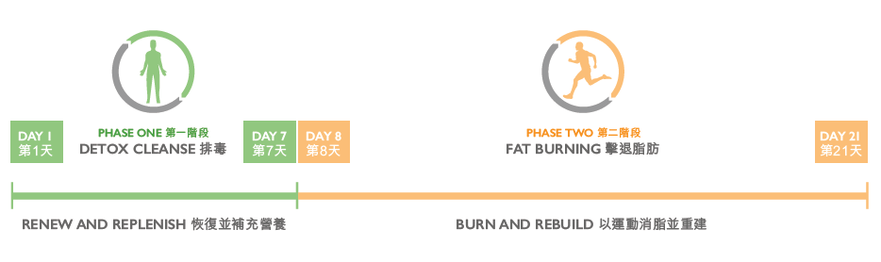
TLS 21- Day Challenge
START LIVING WITH TLS® TODAY
#FINDYOURFIT
#TLSWEIGHTLOSS

Slide 25
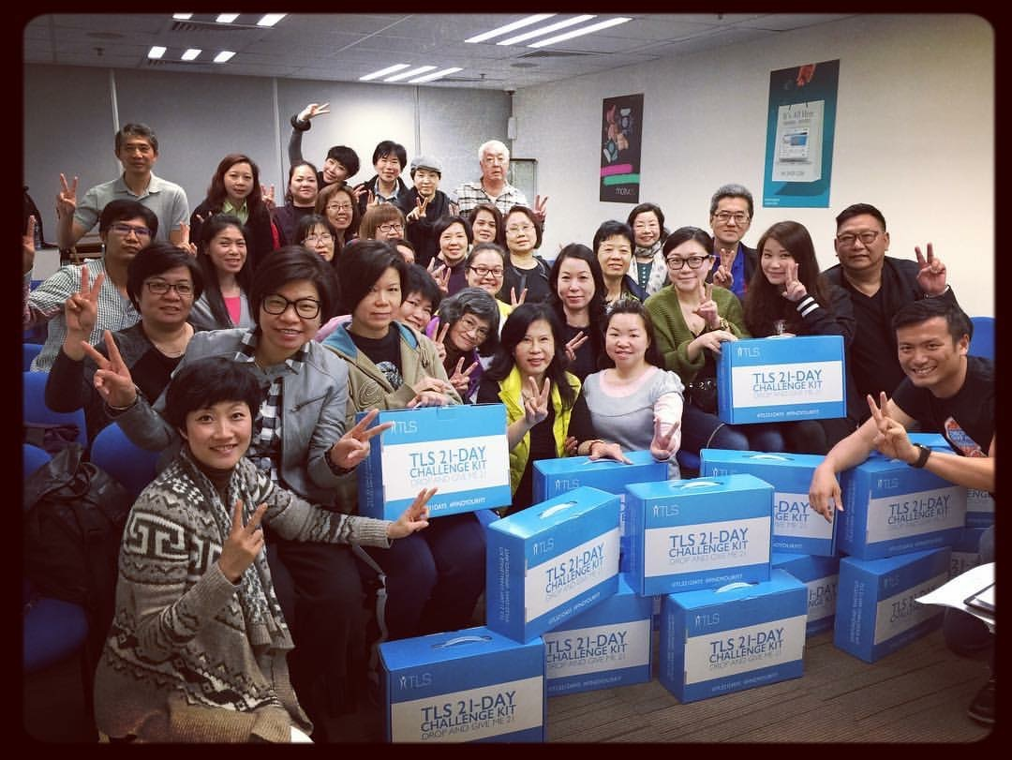

Slide 26
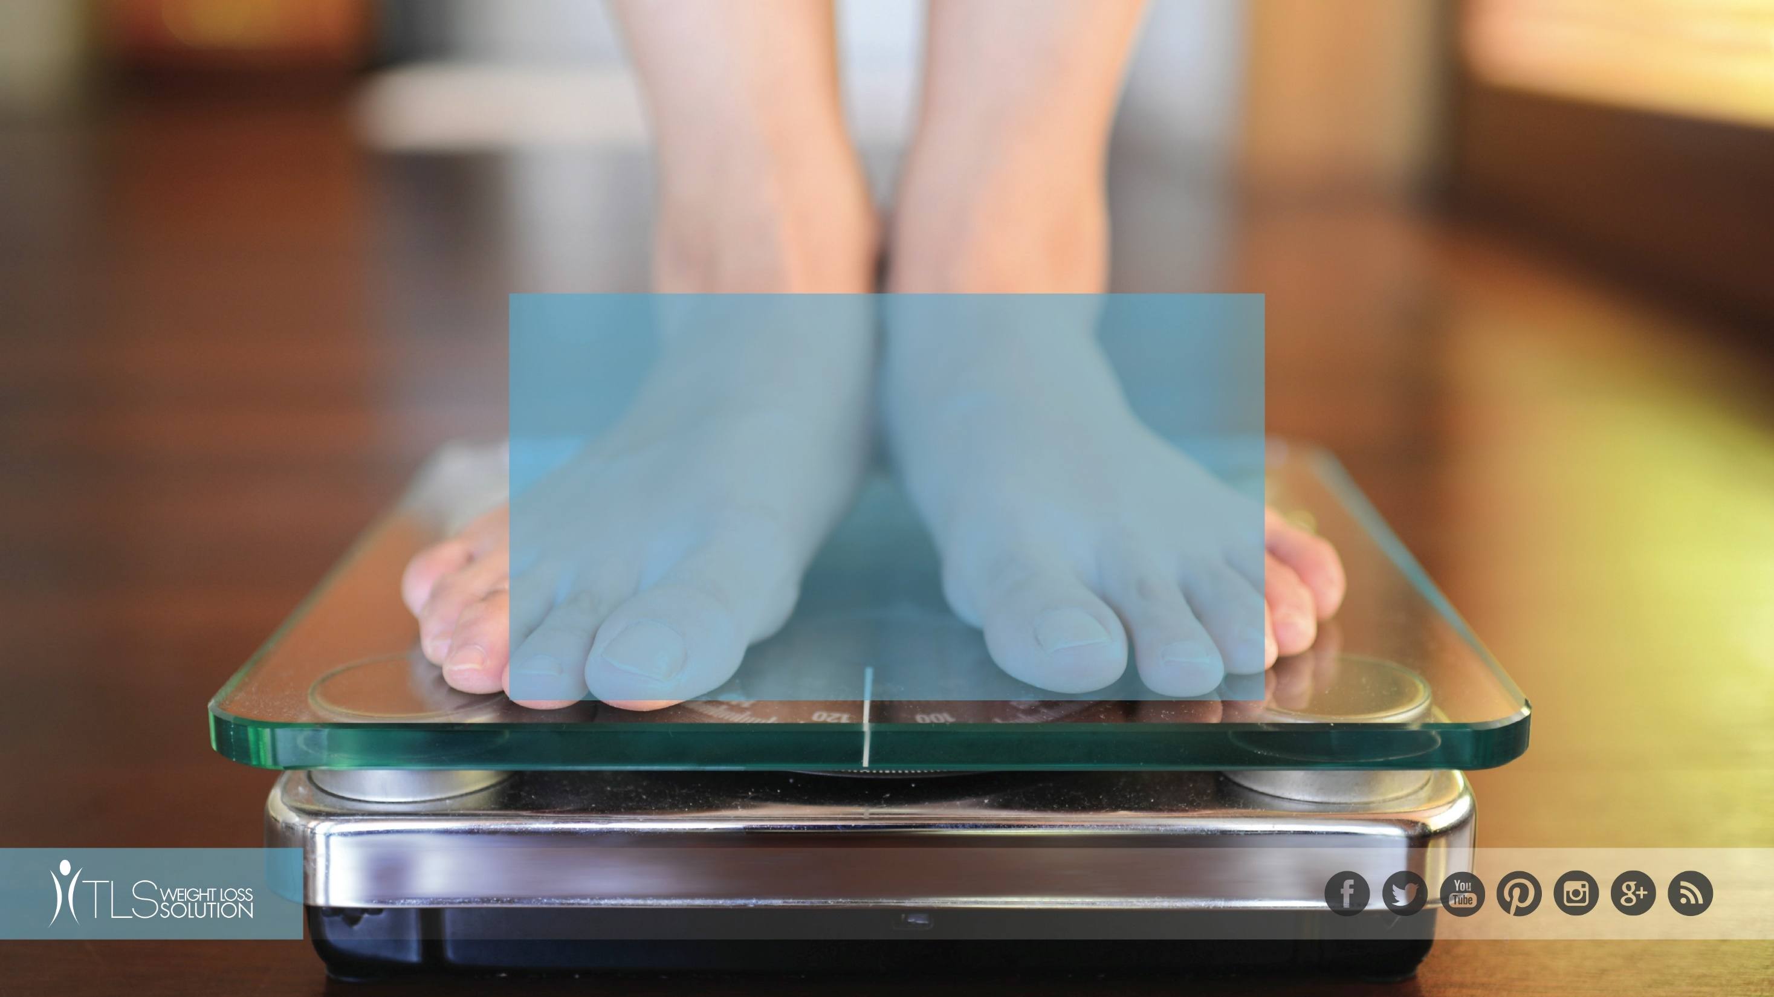
REAL PEOPLE, REAL
STORIES

Slide 27
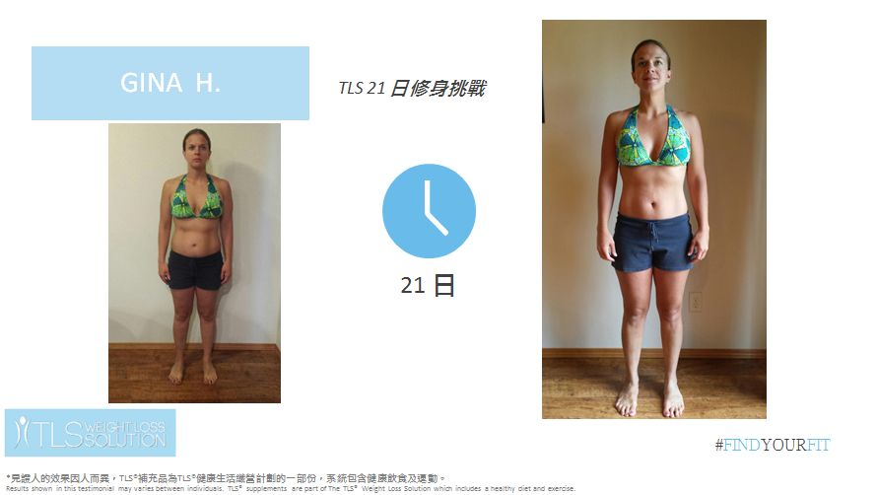
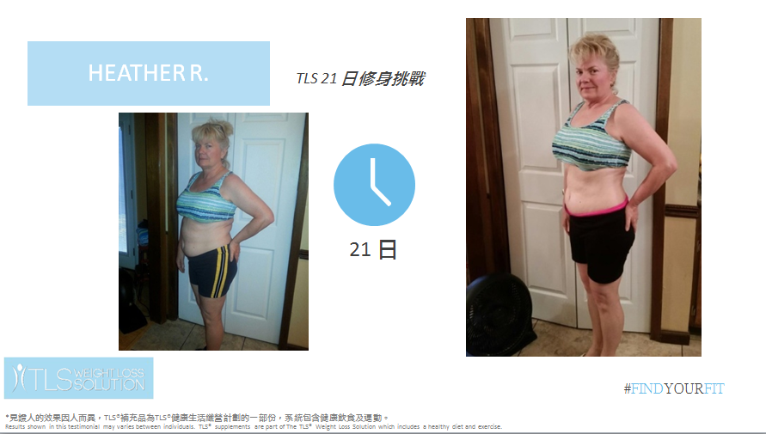
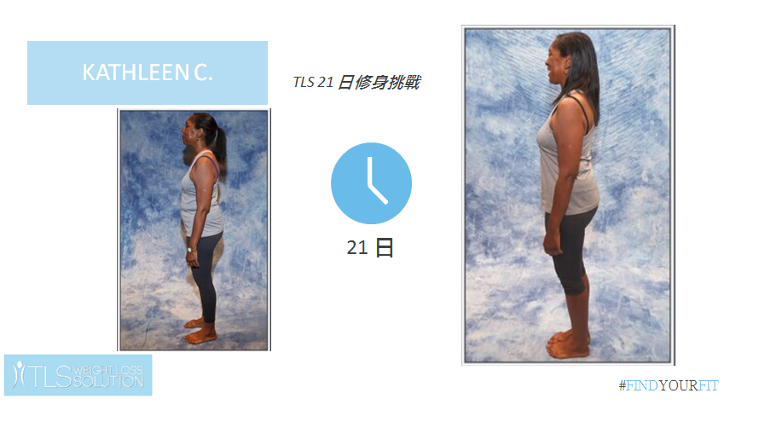
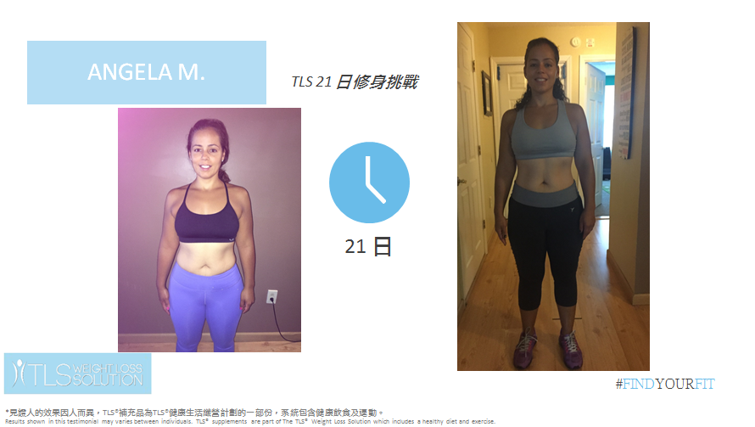

Slide 28
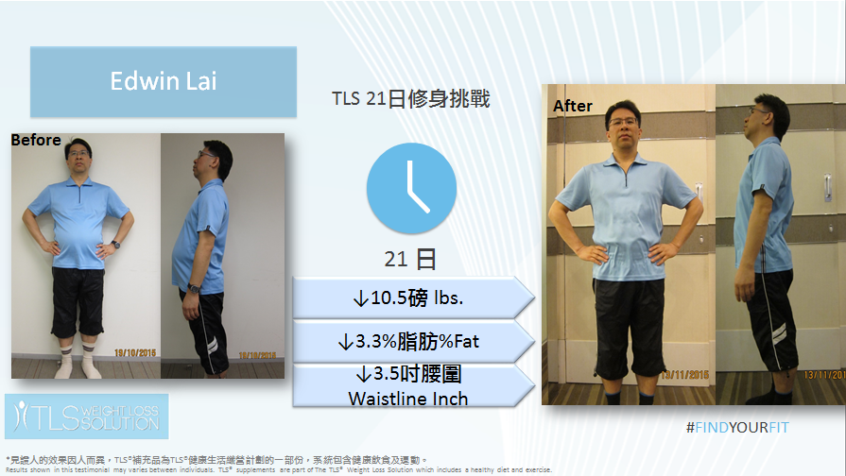
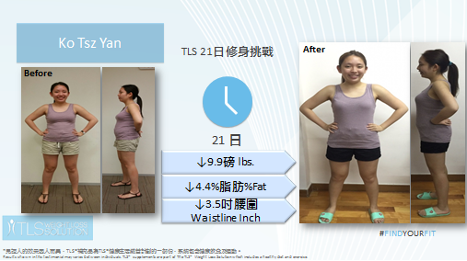
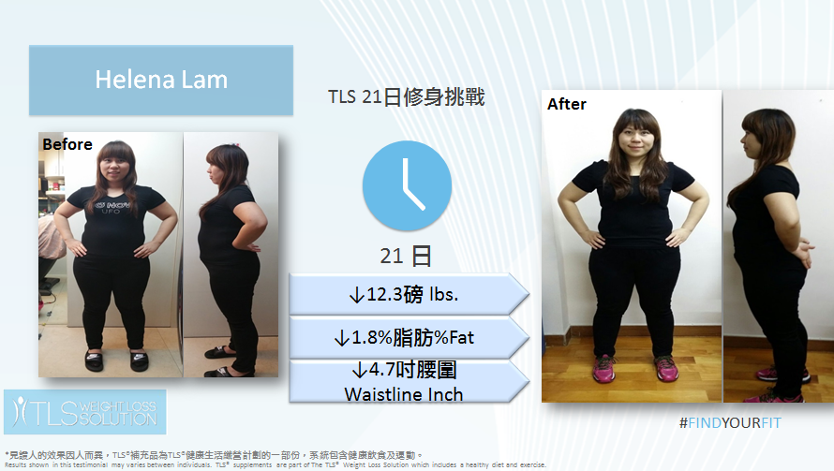
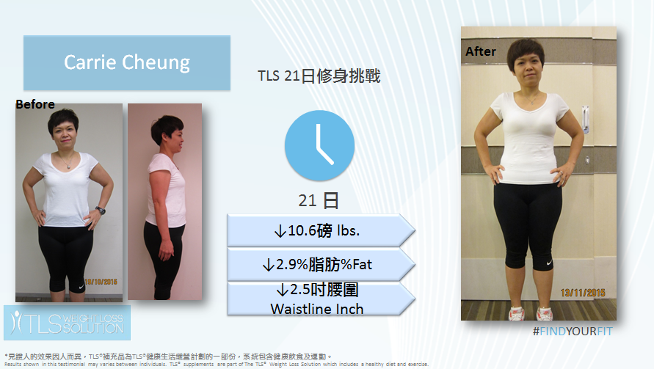

Slide 29
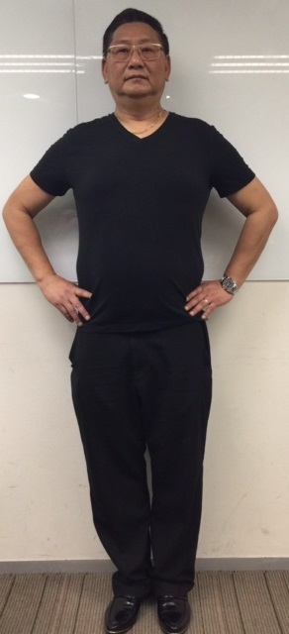
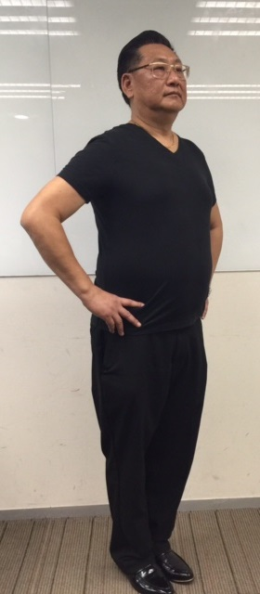
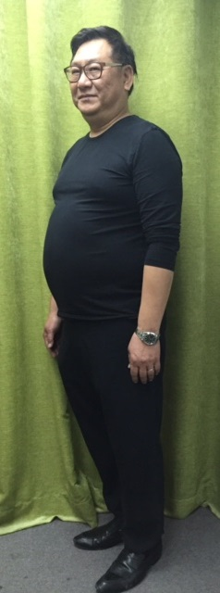
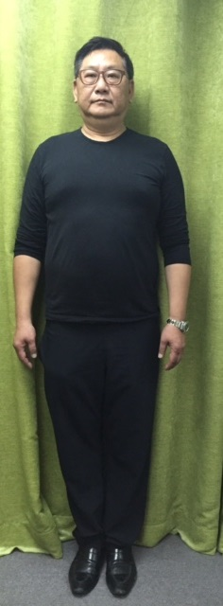
Simon
TLS 21 Day Challenge
21 DAY
↓11.4 lbs.
↓1.8% Fat
#FINDYOURFIT
*見證人的效果因人而異，TLS®補充品為TLS®健康生活纖營計劃的一部份，系統包含健康飲食及運動。
Results shown in this testimonial may varies between individuals. TLS® supplements are part of The TLS® Weight Loss Solution which includes a healthy diet and exercise.

Slide 30
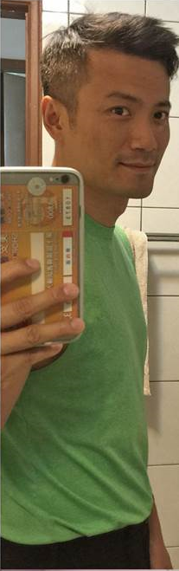
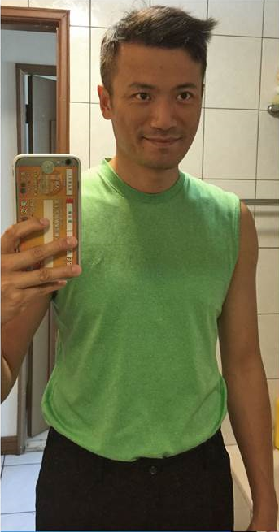
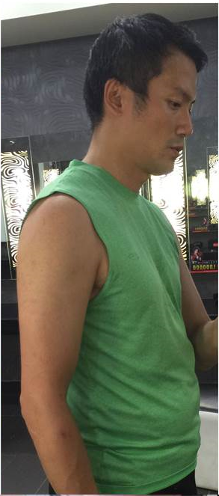
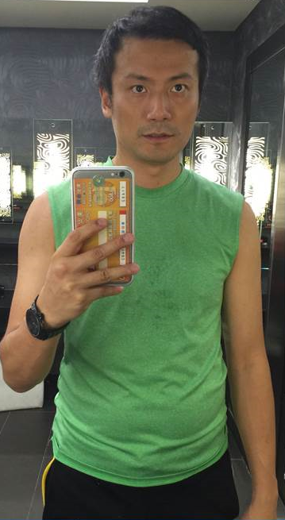
Clemant
TLS 21 Day Challenge
21 DAY
↓10.8 lbs.
↓2.0% Fat
#FINDYOURFIT
*見證人的效果因人而異，TLS®補充品為TLS®健康生活纖營計劃的一部份，系統包含健康飲食及運動。
Results shown in this testimonial may varies between individuals. TLS® supplements are part of The TLS® Weight Loss Solution which includes a healthy diet and exercise.

Slide 31
How do I sell the 21-Day Challenge?
GET CUSTOMERS TO COMMIT TO GET FIT IN JUST 21 DAYS
1
2
3
4
5
PURCHASE
TLS 21 DAY CHALLENGE KITS FOR YOUR INVENTORY ON HK.SHOP.COM
PROMOTE
ON SOCIAL MEDIA WITH OUR VIDEOS, IMAGES AND BLOG POSTS
SECURE CUSTOMERS AND ASK FOR THE ORDER
SELL
THE TLS 21 DAY CHALLENGE KITS
SHARE
YOUR CUSTOMERS’ SUCCESSES WITH US
START LIVING WITH TLS® TODAY
#FINDYOURFIT
#TLSWEIGHTLOSS

Slide 32

®
SELLING
TLS® 21 Day Challenge!
START LIVING WITH TLS® TODAY
#FINDYOURFIT
D
#TLSWEIGHTLOSS

Slide 33
Selling the TLS 21-Day Challenge
Listen for the opportunity...
Ask the simple question... “Have you heard of the TLS 21-Day Challenge?”
Know the answer to “What is it?”
Learn how to Close...Always more than one.
START LIVING WITH TLS® TODAY
#FINDYOURFIT
#TLSWEIGHTLOSS

Slide 34

TLS 21- Day Challenge Kit
SAVE
24%
HK21DAY | UC $1,038.00 | SR $1,452.00 | BV 25.0

Slide 35
TLS 21- Day Challenge – Shopping Annuity
Product | Retail Profit | BV
TLS® 21-Day Challenge Kit | HK$414.00 | 25.0
Isotonix® Digestive Enzyme Powder Drink | HK$82.00 | 18.0
Total: | HK$496.00 | 43
In 4 weeks: |  | 43
430 BV (10 customers) + 100 BV (Self) = 530 BV

Slide 36
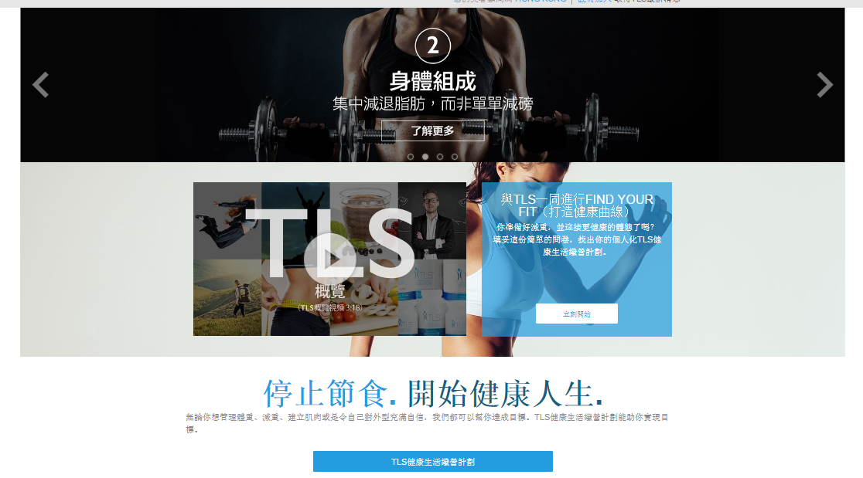

Tools
UNFRANCHISETRAINING.COM:：TLS Business Guide, TLS Overview, TLS 21-Day Challenge Overview
UNFRANCHISE.COM.HK: Downloadable leaflets
GMTSS: TLS Day 1 & DAY 2
FACEBOOK：https://www.facebook.com/tlsmhk/
TLS Website：hk.tlsslim.com

Slide 37
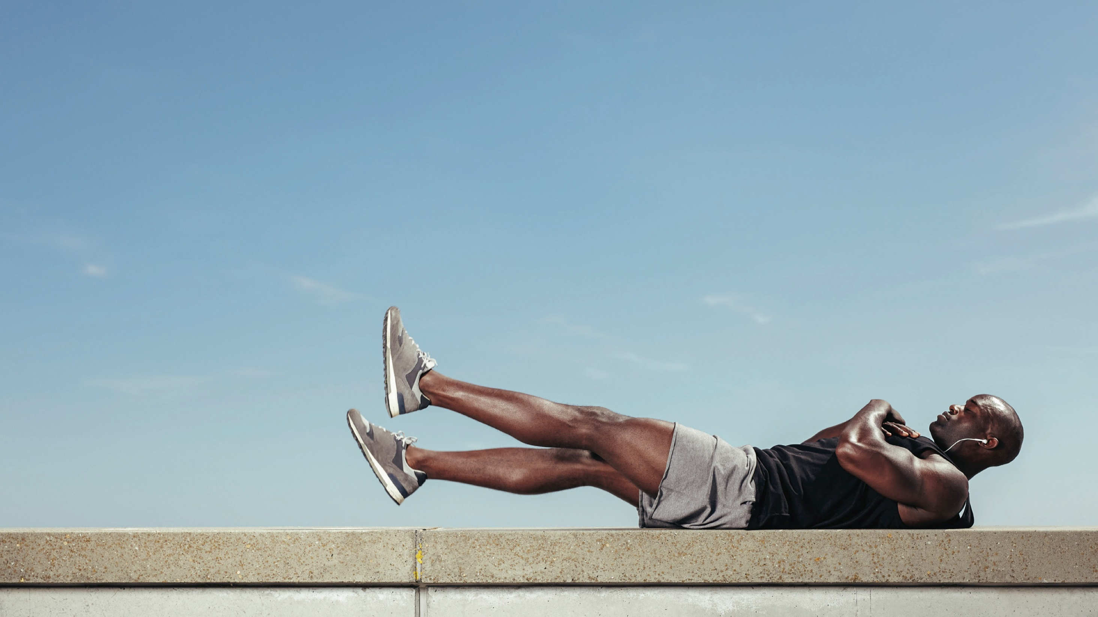
#FINDYOURFIT
THE HEALTHIEST SOCIAL MEDIA AND
LIFESTYLE CLUB ON THE PLANET

Slide 38
®
2016
TLS®健康生活纖形比賽
Find Your Fit Challenge

Slide 39
®
TLS® Find Your Fit Challenge
Win Over HK$53,000 Cash and Product Prizes
Challenge Period: May 2, 2016 – September 23, 2016
Registration Deadline: June 30, 2016 at 11:59PM
Challenge Categories:
12-Week Individual Challenge – Male
12-Week Individual Challenge – Female
START LIVING WITH TLS® TODAY
#FINDYOURFIT
#TLSWEIGHTLOSS

Slide 40
TLS®健康生活纖形比賽
Find Your Fit Challenge
®
Selection of the Winner?
MA TLS® Corporate Team and MHK will select the winners based on:
60% Before & After photos
20% Measurements
20% Testimonial Questionnaire
Challenge Prizes (Male & Female):
1st Place – HK$6,000 + 3 TLS CORE
1st Runner Up – HK$3,500 + 3 TLS CORE
2nd Runner Up – HK$2,500 + 3 TLS CORE
4th & 5th Places – 1 set of Optimal Wellness Kit
“My Favorite FYF Winner” – 1 TLS CORE
Coach of 1st place winner will win 3 months usage of Optimal Wellness Kit
START LIVING WITH TLS® TODAY
#FINDYOURFIT
#TLSWEIGHTLOSS

Slide 41
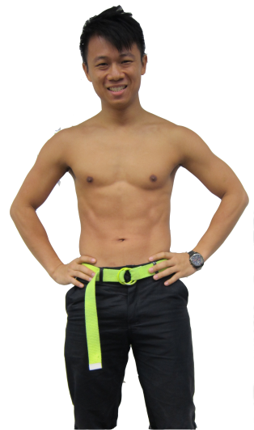
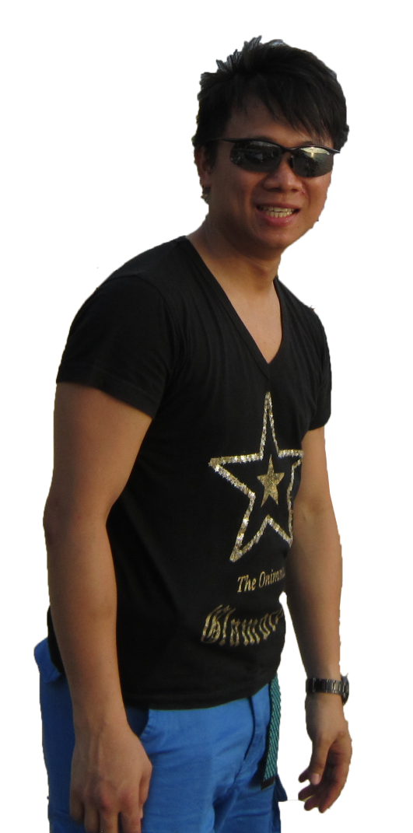
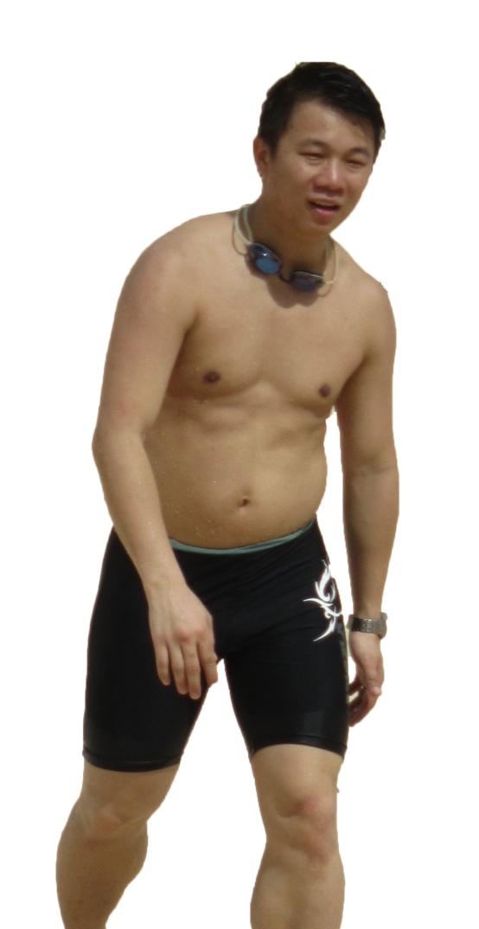
®
TLS Certified Coach – Patrick Cheung
↓23.1 lbs.
↓7.3%Fat
↓7.5
Waistline Inch
*見證人的效果因人而異，TLS®補充品為TLS®健康生活纖營計劃的一部份，系統包含健康飲食及運動。Results shown in this testimonial may varies between individuals. TLS® supplements are part of The TLS® Weight Loss Solution which includes a healthy diet and exercise.

Slide 42
TLS®健康生活纖形比賽
Find Your Fit Challenge
®
Female Category
Top 5 Finalists
START LIVING WITH TLS® TODAY
#FINDYOURFIT
#TLSWEIGHTLOSS

Slide 43
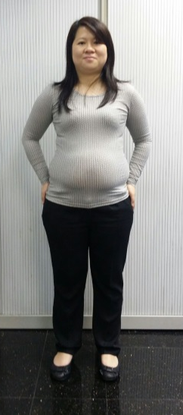
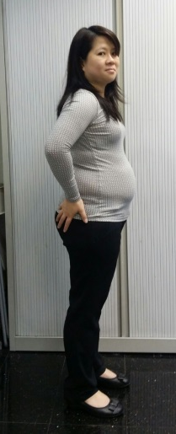
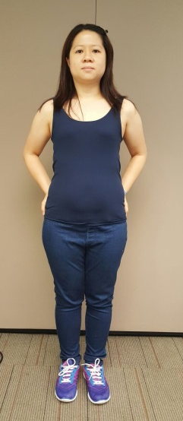
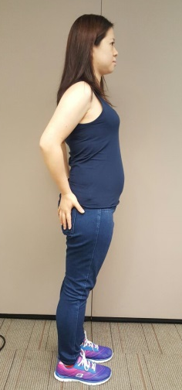
Female Category
#1: Chan Pui Pui Berry
®
↓24.6 lbs.
↓7.5% Fat
↓4.4
Waistline Inch
Coach:
Janice Lee & YK Tam
*見證人的效果因人而異，TLS®補充品為TLS®健康生活纖營計劃的一部份，系統包含健康飲食及運動。Results shown in this testimonial may varies between individuals. TLS® supplements are part of The TLS® Weight Loss Solution which includes a healthy diet and exercise.

Slide 44
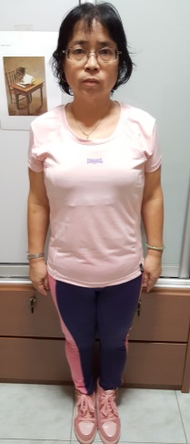



Female Category
#2: Cheng Yuk Chun, Elka
®
↓20.5 lbs.
↓6.4% Fat
↓6.0
Waistline Inch
Coach:
Cheng Yuk Ling
*見證人的效果因人而異，TLS®補充品為TLS®健康生活纖營計劃的一部份，系統包含健康飲食及運動。Results shown in this testimonial may varies between individuals. TLS® supplements are part of The TLS® Weight Loss Solution which includes a healthy diet and exercise.

Slide 45




Female Category
#3: Leung Hoi Kwan, Helen
®
↓11.2 lbs.
↓4.9% Fat
↓5.0
Waistline Inch
Coach: Rayon Lam
*見證人的效果因人而異，TLS®補充品為TLS®健康生活纖營計劃的一部份，系統包含健康飲食及運動。Results shown in this testimonial may varies between individuals. TLS® supplements are part of The TLS® Weight Loss Solution which includes a healthy diet and exercise.

Slide 46




Female Category
#4: Ma Siu Ha, Yuki
®
↓15.4 lbs.
↓7.1% Fat
↓4.0
Waistline Inch
Coach: Rayon Lam
*見證人的效果因人而異，TLS®補充品為TLS®健康生活纖營計劃的一部份，系統包含健康飲食及運動。Results shown in this testimonial may varies between individuals. TLS® supplements are part of The TLS® Weight Loss Solution which includes a healthy diet and exercise.

Slide 47




Female Category
#5: Yuen Yiu Kwan
®
↓15.4 lbs.
↓8.1% Fat
↓6.5
Waistline Inch
Coach:
Patrick Cheung
*見證人的效果因人而異，TLS®補充品為TLS®健康生活纖營計劃的一部份，系統包含健康飲食及運動。Results shown in this testimonial may varies between individuals. TLS® supplements are part of The TLS® Weight Loss Solution which includes a healthy diet and exercise.

Slide 48
TLS®健康生活纖形比賽
Find Your Fit Challenge
®
Male Category
Top 5 Finalists
START LIVING WITH TLS® TODAY
#FINDYOURFIT
#TLSWEIGHTLOSS

Slide 49




Male Category
#1: Chan Lun Kai, Toby
®
↓18.0 lbs.
↓8.6% Fat
↓5.3
Waistline Inch
Coach: Chan Nga Fun
*見證人的效果因人而異，TLS®補充品為TLS®健康生活纖營計劃的一部份，系統包含健康飲食及運動。Results shown in this testimonial may varies between individuals. TLS® supplements are part of The TLS® Weight Loss Solution which includes a healthy diet and exercise.

Slide 50


Male Category
#2: Lau Shun Hong, Olympian
®
↓24.0 lbs.
↓2.2% Fat
↓6.2
Waistline Inch
Coach: Ray Chui
*見證人的效果因人而異，TLS®補充品為TLS®健康生活纖營計劃的一部份，系統包含健康飲食及運動。Results shown in this testimonial may varies between individuals. TLS® supplements are part of The TLS® Weight Loss Solution which includes a healthy diet and exercise.

Slide 51




Male Category
#3: Leung Chun Shek, Chris
®
↓26.2 lbs.
↓5.8% Fat
↓7.5
Waistline Inch
Coach:
Luk Ka Wai & Helen Lin
*見證人的效果因人而異，TLS®補充品為TLS®健康生活纖營計劃的一部份，系統包含健康飲食及運動。Results shown in this testimonial may varies between individuals. TLS® supplements are part of The TLS® Weight Loss Solution which includes a healthy diet and exercise.

Slide 52




Male Category
#4: Leung Chuen Kwok, Rockie
®
↓24.9 lbs.
↓7.3% Fat
↓8.5
Waistline Inch
Coach:
Luk Ka Wai & Helen Lin
*見證人的效果因人而異，TLS®補充品為TLS®健康生活纖營計劃的一部份，系統包含健康飲食及運動。Results shown in this testimonial may varies between individuals. TLS® supplements are part of The TLS® Weight Loss Solution which includes a healthy diet and exercise.

Slide 53




Male Category
#5: Yee Eagle
®
↓21.6 lbs.
↓2.6% Fat
↓6.7
Waistline Inch
Coach: Lily Wong
*見證人的效果因人而異，TLS®補充品為TLS®健康生活纖營計劃的一部份，系統包含健康飲食及運動。Results shown in this testimonial may varies between individuals. TLS® supplements are part of The TLS® Weight Loss Solution which includes a healthy diet and exercise.

Slide 54
TLS®健康生活纖形比賽
Find Your Fit Challenge
®
“My Favorite FYF Winner”
Female Category
Prize: 1 bottle of TLS® CORE
START LIVING WITH TLS® TODAY
#FINDYOURFIT
#TLSWEIGHTLOSS

Slide 55
TLS®健康生活纖形比賽
Find Your Fit Challenge
®
3rd Place Winner
Female Category
Yuen Yiu Kwan
Prize: HK$2,500 + 3 bottles of TLS® CORE
START LIVING WITH TLS® TODAY
#FINDYOURFIT
#TLSWEIGHTLOSS

Slide 56
2016 TLS® FYF Challenge
3rd Place: Yuen Yiu Kwan
®
↓15.4 lbs.
↓8.1% Fat
↓6.5
Waistline Inch
Coach:
Patrick Cheung
*見證人的效果因人而異，TLS®補充品為TLS®健康生活纖營計劃的一部份，系統包含健康飲食及運動。Results shown in this testimonial may varies between individuals. TLS® supplements are part of The TLS® Weight Loss Solution which includes a healthy diet and exercise.

Slide 57
TLS®健康生活纖形比賽
Find Your Fit Challenge
®
2nd Runner Up
Female Category
Chan Pui Pui Berry
Prize: HK$3,500 + 3 bottles of TLS® CORE
START LIVING WITH TLS® TODAY
#FINDYOURFIT
#TLSWEIGHTLOSS

Slide 58
2016 TLS® FYF Challenge
2nd Place: Chan Pui Pui
®
↓24.6 lbs.
↓7.5% Fat
↓4.4
Waistline Inch
Coach:
Janice Lee & YK Tam
*見證人的效果因人而異，TLS®補充品為TLS®健康生活纖營計劃的一部份，系統包含健康飲食及運動。Results shown in this testimonial may varies between individuals. TLS® supplements are part of The TLS® Weight Loss Solution which includes a healthy diet and exercise.

Slide 59
TLS®健康生活纖形比賽
Find Your Fit Challenge
®
Champion
Female Category
Ma Siu Ha, Yuki
Prize: HK$6,000 + 3 bottles of TLS® CORE
START LIVING WITH TLS® TODAY
#FINDYOURFIT
#TLSWEIGHTLOSS

Slide 60
2016 TLS® FYF Challenge
Champion: Ma Siu Ha, Yuki
®
↓15.4 lbs.
↓7.1% Fat
↓4.0
Waistline Inch
Coach: Rayon Lam
*見證人的效果因人而異，TLS®補充品為TLS®健康生活纖營計劃的一部份，系統包含健康飲食及運動。Results shown in this testimonial may varies between individuals. TLS® supplements are part of The TLS® Weight Loss Solution which includes a healthy diet and exercise.

Slide 61
TLS®健康生活纖形比賽
Find Your Fit Challenge
®
“My Favorite FYF Winner”
Male Category
Prize: 1 bottle of TLS® CORE
START LIVING WITH TLS® TODAY
#FINDYOURFIT
#TLSWEIGHTLOSS

Slide 62
TLS®健康生活纖形比賽
Find Your Fit Challenge
®
3rd Place Winner
Male Category
Lau Shun Hong, Olympian
Prize: HK$2,500 + 3 bottles of TLS® CORE
START LIVING WITH TLS® TODAY
#FINDYOURFIT
#TLSWEIGHTLOSS

Slide 63
2016 TLS® FYF Challenge
3rd Place: Lau Shun Hong, Olympian
®
↓24.0 lbs.
↓2.2% Fat
↓6.2
Waistline Inch
Coach: Ray Chui
*見證人的效果因人而異，TLS®補充品為TLS®健康生活纖營計劃的一部份，系統包含健康飲食及運動。Results shown in this testimonial may varies between individuals. TLS® supplements are part of The TLS® Weight Loss Solution which includes a healthy diet and exercise.

Slide 64
TLS®健康生活纖形比賽
Find Your Fit Challenge
®
2nd Runner Up
Male Category
Leung Chuen Kwok, Rockie
Prize: HK$3,500 + 3 bottles of TLS® CORE
START LIVING WITH TLS® TODAY
#FINDYOURFIT
#TLSWEIGHTLOSS

Slide 65
2016 TLS® FYF Challenge
2nd Place: Leung Chuen Kwok, Rockie
®
↓24.9 lbs.
↓7.3% Fat
↓8.5
Waistline Inch
Coach:
Luk Ka Wai & Helen Lin
*見證人的效果因人而異，TLS®補充品為TLS®健康生活纖營計劃的一部份，系統包含健康飲食及運動。Results shown in this testimonial may varies between individuals. TLS® supplements are part of The TLS® Weight Loss Solution which includes a healthy diet and exercise.

Slide 66
TLS®健康生活纖形比賽
Find Your Fit Challenge
®
Champion
Male Category
Leung Chun Shek, Chris
Prize: HK$6,000 + 3 bottles of TLS® CORE
START LIVING WITH TLS® TODAY
#FINDYOURFIT
#TLSWEIGHTLOSS

Slide 67
2016 TLS® FYF Challenge
Champion: Leung Chun Shek, Chris
®
↓26.2 lbs.
↓5.8% Fat
↓7.5
Waistline Inch
Coach:
Luk Ka Wai & Helen Lin
*見證人的效果因人而異，TLS®補充品為TLS®健康生活纖營計劃的一部份，系統包含健康飲食及運動。Results shown in this testimonial may varies between individuals. TLS® supplements are part of The TLS® Weight Loss Solution which includes a healthy diet and exercise.

Slide 68

TLS® + Motives® Breakout
November 16, 2016 (Wednesday)
8:00 - 10:00 p.m.

